Slide 1

AI Stock Insights
Executive Summary
Project Overview: Develop a user-input based stock analysis tool focused on AI companies, providing stock recommendations based on user-defined risk/return criteria, historical trends, and future price predictions.
.

Slide 2

Executive Summary
Project Overview: Develop comprehensive stock analysis code that provides:
Insights on comparing one or many –
What is the best day of the week to purchase?
What is the cumulative percentage change in price?
Historical trend analysis
Stock Comparison of:
Moving Average, Sharpe Ratio, Volatility, CAGR, RSI, Beta, Max Drawdown, Points

Slide 3

Danny Srour
Read.md file
Visualization
Github Version control
Caleb Kelson
Contributor
Visualization
Ryan Brown
Data Cleaning
Visualization
Cathy Schassberger
Contributor
Presentation
Daniel Liu
Contributor
Visualization
Austin Cappetta
Contributor
Visualization

Slide 4
Project Approach
Our group’s approach to achieving the project goals involved several structured and collaborative steps:
Initial planning and goal setting
Outline the primary objective:
Develop stock analysis code focused on AI companies. This tool would provide analysis so a reader could identify stock recommendations based on historical trends, stock comparison, future price predictions and the best day of the week to make a purchase.
Stock Selection
Six prominent AI-related companies were the focus:
NVIDIA, Amazon, Oracle, Meta Platforms, Alphabet Inc and Tesla. The companies were selected based on their significant impact on the AI industry.
Data Collection
Five years of historical data from November 2019 to November 2024.
Data included prices and relevant financial metrics for the selected companies.
Reliable financial databases were used to ensure the accuracy and completeness of the data.
Data Cleaning
The data was meticulously cleaned to handle missing values, outliers and inconsistencies. This step was
crucial to ensure that our analysis and predictions would be based on high-quality and reliable data.

Slide 5
Data Exploration
Data was explored to understand trends, patterns and relationships. This step involved visualizing the data, performing statistical analyses, and identifying key insights.
User input and interaction design
The tool was designed to be user-friendly, allowing users to input their risk tolerance and desired returns.
The tool provides a list of AI stocks for selection and offers interactive elements to enhance user engagement.
Visualization and reporting
Interactive charts and graphs were created to visualize stock performance and trends.
The visualizations help users make informed decisions by providing clear and comprehensive insights.
Testing and refinement
Thorough testing was conducted to ensure the code’s functionality and accuracy.
Team feedback was gathered and incorporated to refine and improve the code.
Deployment and Future Enhancements
The code was finalized and deployed.
Planning future enhancements were discussed such as integrating additional AI companies, adding prediction algorithms, and incorporating user interaction.
The structured approach ensured that we stayed focused on our goals, collaborated effectively, and delivered a robust Stock analysis code.

Slide 6
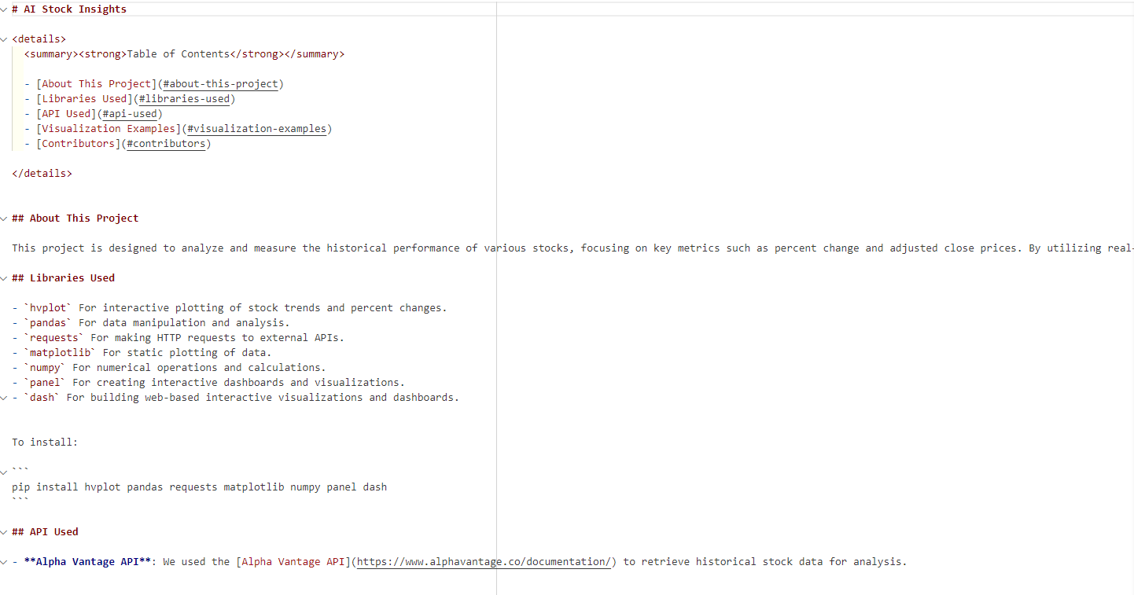
README.MD

Slide 7

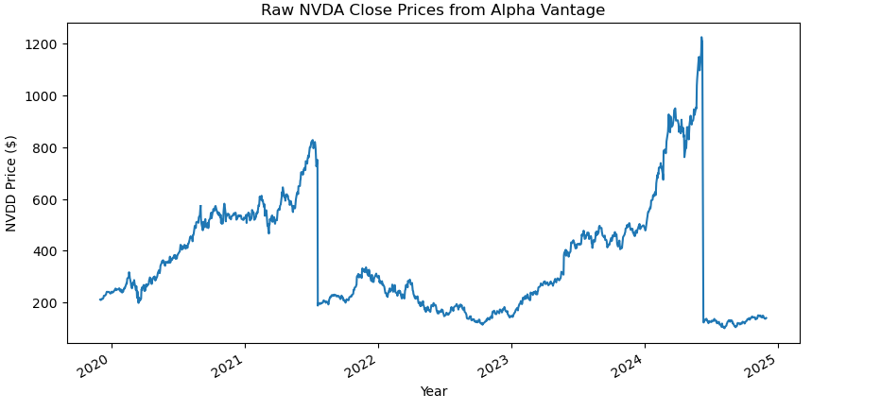
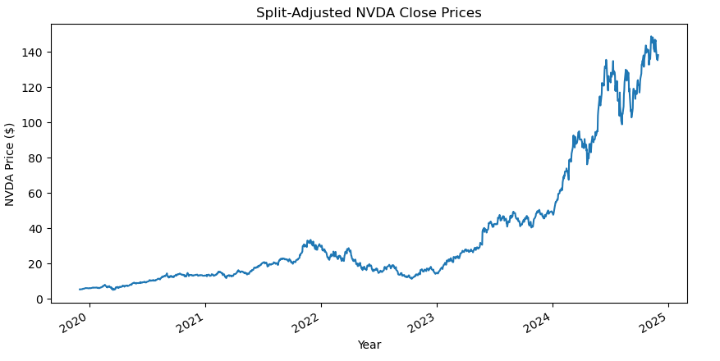
Major Inconsistency: The Stock Split
When pulling the data for the stocks, it was observed that an anomaly had occurred. Upon further investigation, it was determined that some of the stocks had undergone a stock split. When a stock split happens, the total number of shares increases while the price per share decreases proportionally, ensuring the market capitalization remains the same. This corporate action can affect historical price data and the volume, necessitating adjustments to maintain consistency in financial analysis and reporting.
Below is are the graphs illustrating the stock prices before the split and after the split.
Nvidea

Slide 8
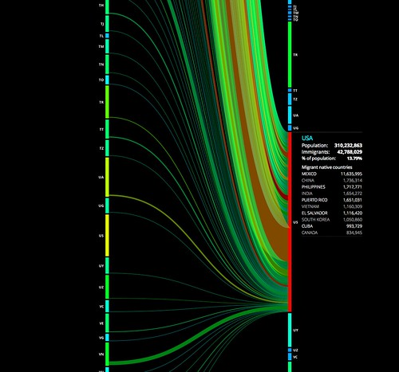
Explorations
and
Visualizations

Slide 9
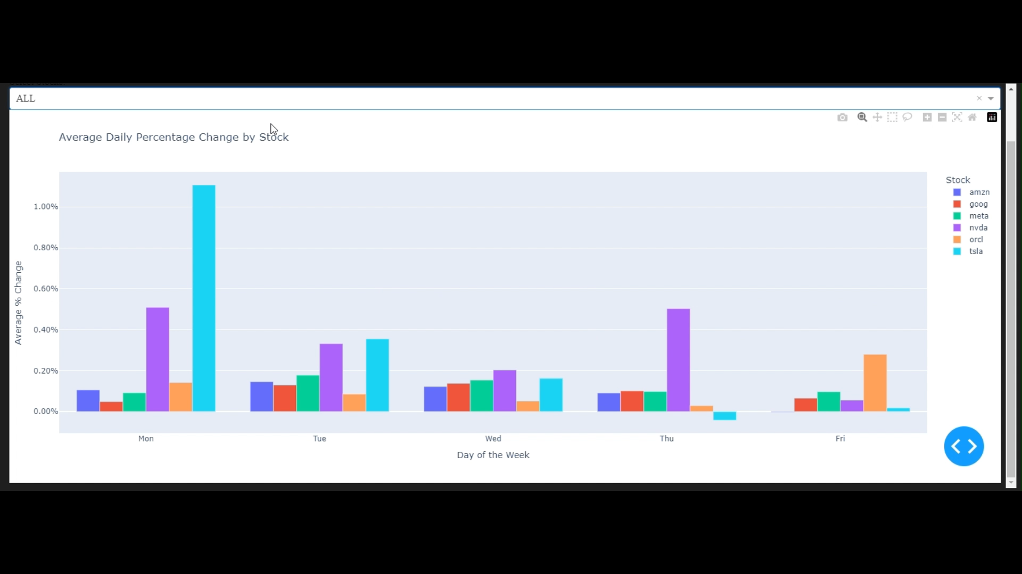
Question 1 – Comparing one or all stocks what is the best day of the week to purchase?

Slide 10
Analysis of Average Daily Percentage Change by Stock This chart highlights the average daily percentage changes for six major AI stocks across the week, revealing key trends and opportunities for investors:
Tesla (TSLA):
Monday sees the largest spike (>1%), making it the least favorable day to buy due to high price increases.
Minimal movement on Thursday and Friday suggests better stability.
Nvidia (NVDA):
Notable volatility on Monday and Thursday (~0.5% increase) indicates active trading on these days.
Wednesday offers more stability.
Meta (META):
Consistent and stable performance throughout the week, with slight increases mid-week.
Ideal for risk-averse investors.
Amazon (AMZN) & Google (GOOG):
Show small, steady increases, especially on Tuesday and Wednesday, offering stable entry points.
Oracle (ORCL):
Friday stands out with a spike, suggesting end-of-week trading optimism.
Key Takeaways
Avoid Tesla and Nvidia on Mondays due to sharp price increases.
Mid-week (Tuesday/Wednesday) provides stability for most stocks.
Meta remains the least volatile option, while Oracle sees late-week activity.
Investors can use these trends to time their trades strategically and align with their goals.

Slide 11
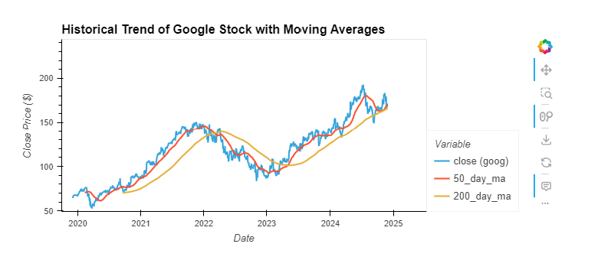
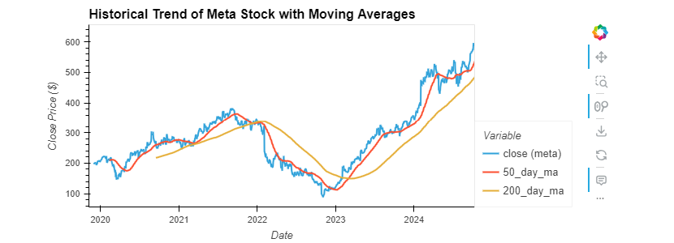
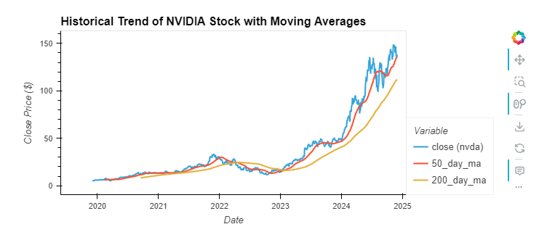
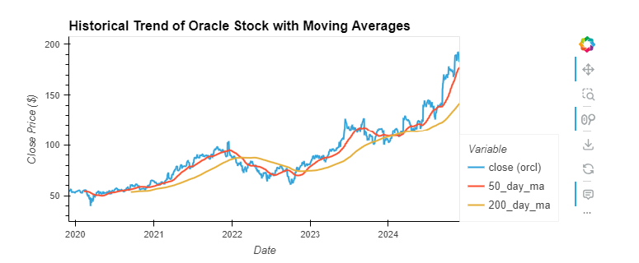
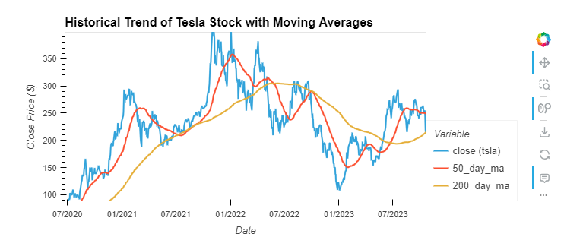
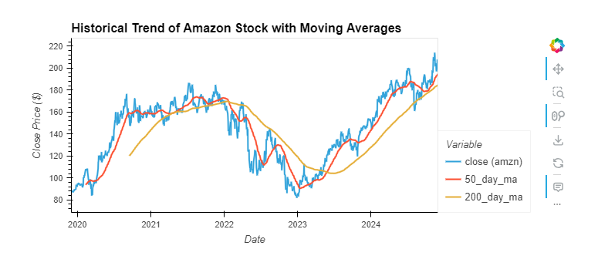
Question 2 – What are the historical trends

Slide 12
5-year Historical Trend Analysis
The stocks all had growth over the time, had market fluctuations during 2022 but recovered and had strong recoveries in 2023 and 2024. Meta and Nvidia had some of the most dramatic price increases in 2023 and 2024
Google Stock – Stock price has shown notable growth. In 2019 - showing a slight decline. In 2020 the stock price rebounded, marking a notable increase. 2021- continued its upward trend, reflecting a strong performance. 2022 – The stock declined, due to market fluctuations. 2023 – The price recovered, showing a positive trend. 2024 – The price has continued to rise. Overall, Google’s stock price has increased significantly, with a notable rise in 2021 and 2023.
Nvidia – Stock price has shown remarkable growth. 2019 – The stock price showed a positive increase. 2020- The stock price continues its upward trend, reflecting strong performance. 2021 – The stock saw even more growth, marking a substantial rise. 2022-The stock price experienced a slight decline, due to market fluctuations. 2023 – The stock price recovered, showing a positive trend. Overall, Nvidia’s stock price has increased significantly, notable rises in 2021 and 2023
Amazon – Stock price has shown significate growth. In 2019 – The stock price showed notable increase. 2020 – The stock price continued its upward trend, marking a substantial rise. 2021 – The stock saw even more growth, marking an increase. 2022 – The stock price experienced a slight decline, due to market fluctuation. 2023 – The stock price recovered, showing a positive trend. Overall, Amazon’s stock price has increased significantly, notable rises in 2020 and 2023.
Meta Platforms – Stock price has experienced considerable fluctuations. 2019 – Prices showed a slight decline. 2020 – Stock price rebounded, showing a notable increase. 2021 – Stock continued its upward trend reflecting strong performance. 2022 – The price experienced a decline due to market fluctuations. 2023 – The stock recovered showing a major increase. 2024 – The price has continued to rise. Overall, Meta’s price has increased significantly, with notable rises in 2021 and 2023
Alphabet – Stock price has shown meaningful growth. 2019 – The stock price ended the year showing a notable increase. 2020 – The price continued its upward trend, reflecting strong performance. 2021 – The price saw even more growth, marking a substantial rise. 2022 – the price experience a decline due to market conditions. 2023 – The price recovered closing on a positive trend. 2024 – The stock price has continued to rise. Overall, Alphabet’s stock has increased significantly with notable rises in 2021 and 2023.
Tesla – Stock prices have shown a prominent growth. 2019 – showed a notable increase. 2020 – The stock continued its upward trend, reflecting strong performance. 2021 – The price saw a decline due to market fluctuations. 2023 – The price recovered showing a positive trend. 2024 – prices continued to rise. Overall, Tesla’s stock price has increased, notable rises in 2020 and 2023.

Slide 13
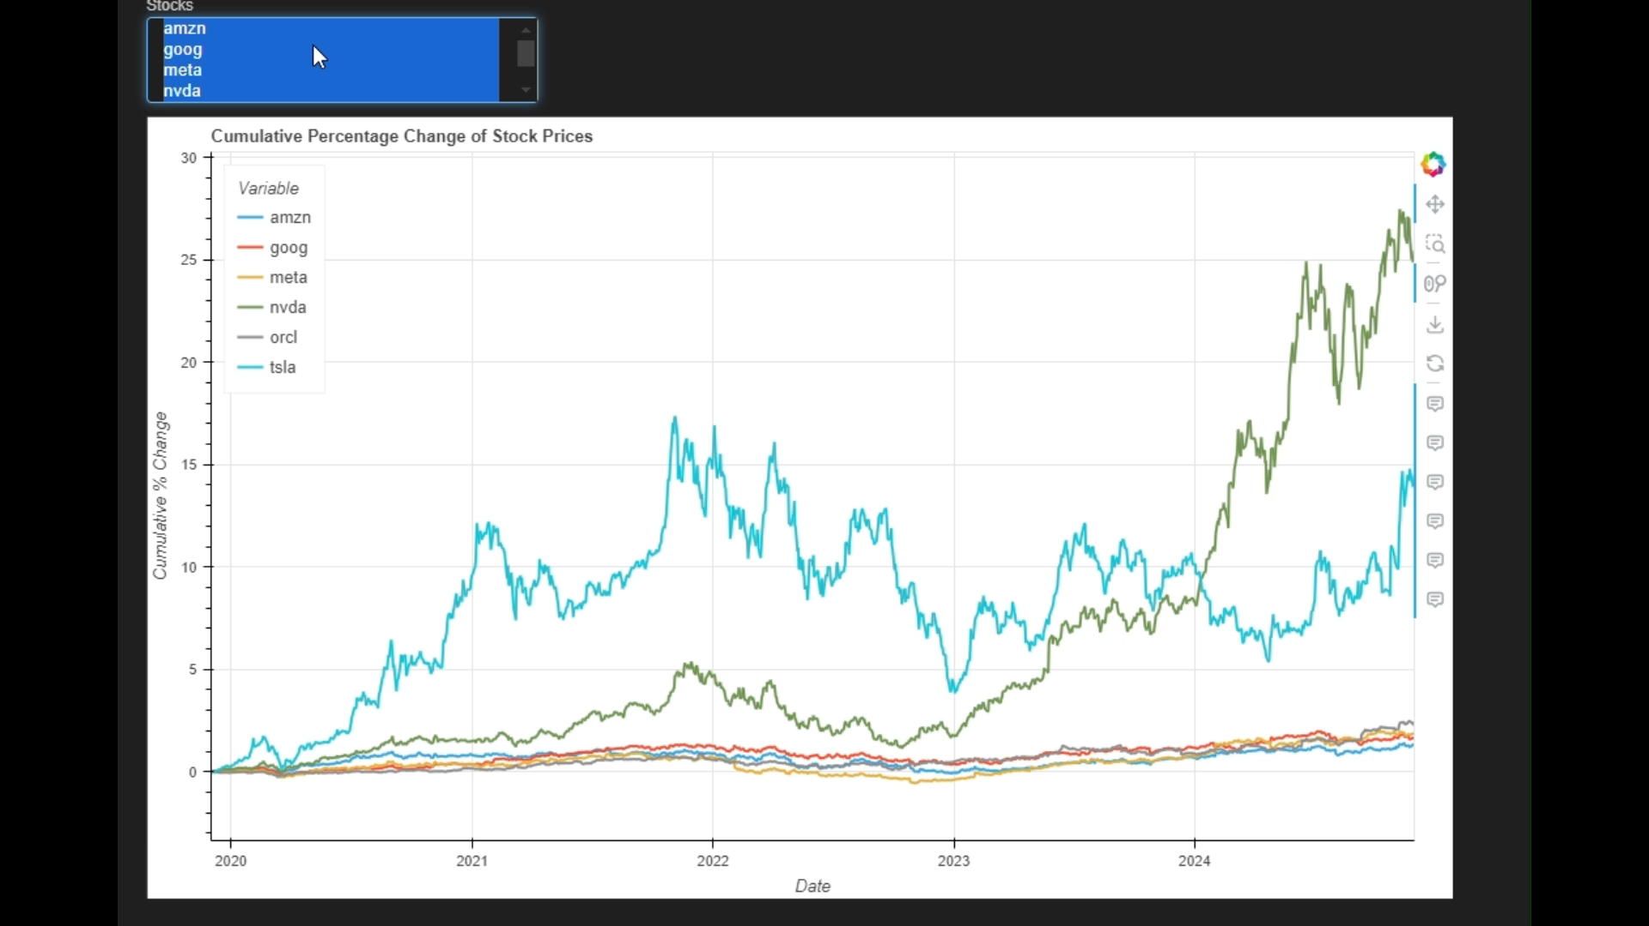
Question 3 – Culminative percentage change?

Slide 14
Analysis of Cumulative Percentage Change of Stock Prices This graph displays the cumulative percentage change of six major AI stocks (Amazon, Google, Meta, Nvidia, Oracle, and Tesla) from 2020 to early 2025. The chart provides a clear view of long-term growth trends and comparative performance.Key
Observations
NVIDIA (NVDA):
Exceptional Growth: Nvidia demonstrates the most significant cumulative percentage growth, reaching over 2500% by 2024.
The sharp upward trajectory began in early 2023, indicating massive investor confidence, likely fueled by advancements in AI technologies, data centers, and GPU demand.
Tesla (TSLA):
Tesla saw substantial growth, peaking at over 1500% in 2022 before experiencing notable volatility.
Despite fluctuations, Tesla maintains a strong upward trend, suggesting its leadership in the electric vehicle and energy sectors continues to drive investor interest.
Meta (META):
Meta shows steady but moderate growth, with cumulative changes around 300%-400%.
Its consistent performance highlights stability in the tech and AI-driven advertising markets.
Amazon (AMZN), Google (GOOG), and Oracle (ORCL):
These three stocks exhibit comparatively flat growth, staying in the 0-200% range.
Amazon and Google maintain slight upward trends, reflecting steady market performance without the sharp spikes seen in Nvidia or Tesla.
Oracle shows minimal cumulative growth, suggesting limited volatility but also less investor-driven momentum.
Key Takeaways NVIDIA has outperformed all other stocks, experiencing explosive growth since 2023, positioning itself as a leading AI and semiconductor stock.
Tesla demonstrates strong long-term growth with significant volatility, offering both opportunities and risks for investors.
Meta provides steady, moderate returns, ideal for risk-averse investors looking for consistent performance.
Amazon, Google, and Oracle show limited cumulative growth, making them stable but less aggressive options for investors seeking rapid gains.
Conclusion The graph underscores Nvidia's dominance in cumulative percentage growth, followed by Tesla. Investors should consider Nvidia’s momentum for high-growth opportunities while understanding the inherent volatility. For more stable returns, stocks like Meta, Amazon, and Google remain reliable long-term options.

Slide 15
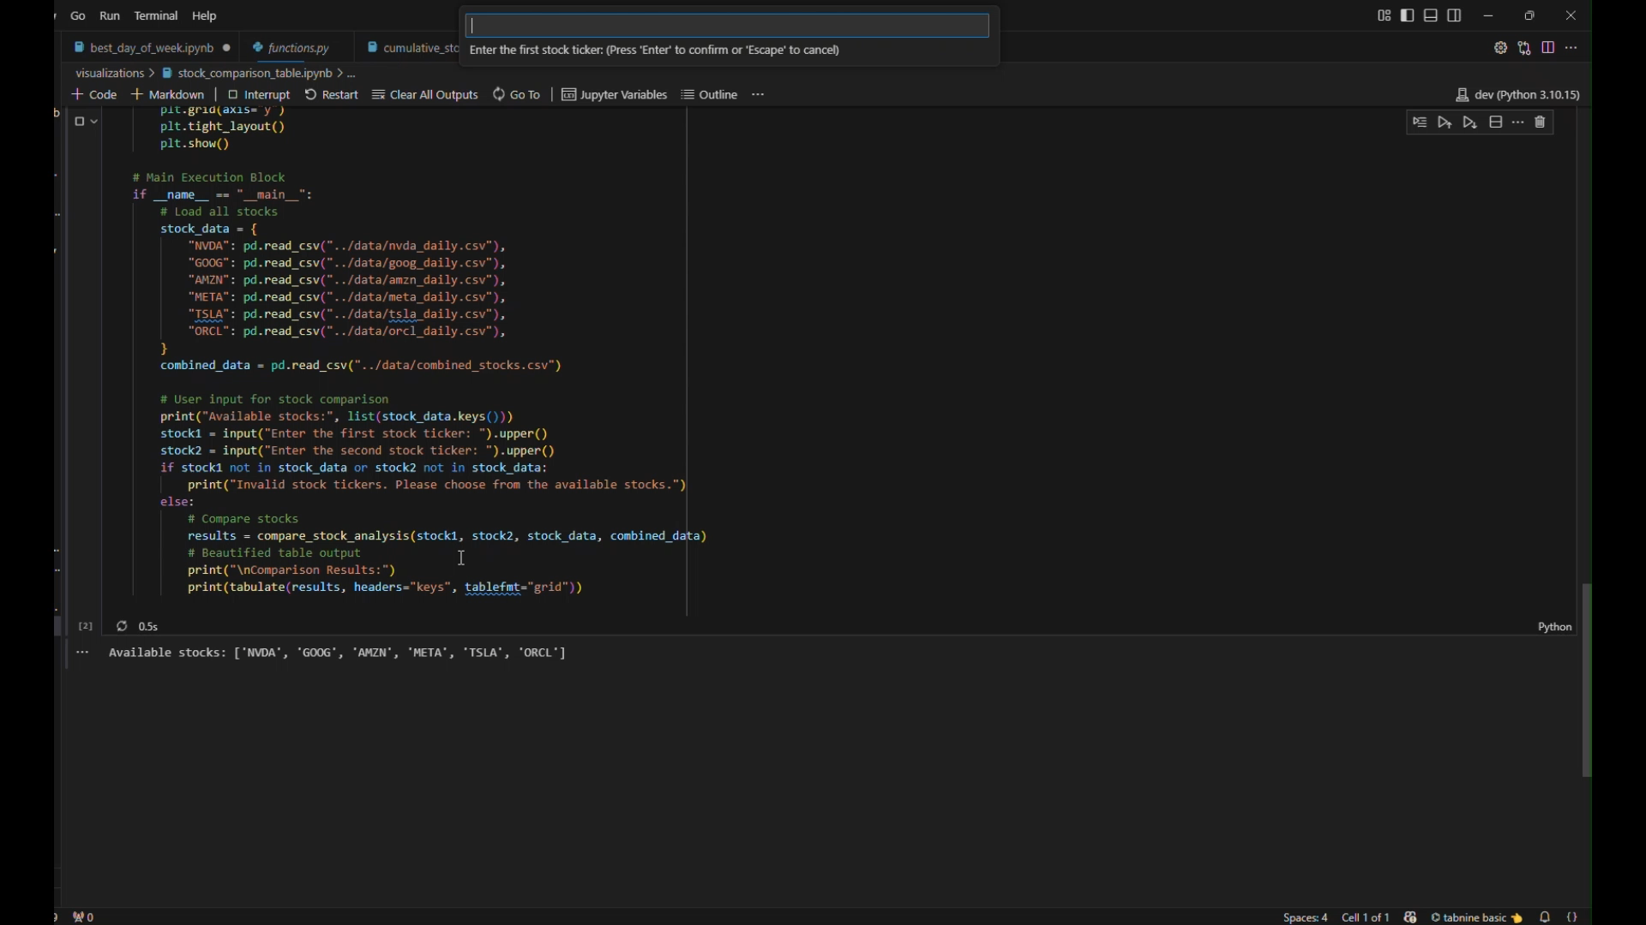
Question 4 – Stock Comparison

Slide 16
The table summarizes the comparison of two selected stocks across seven financial metrics. The metrics we have selected are (read off list). The best-performing stock for each metric is marked with a ★. A "Points" column tallies the total points for each stock based on their performance, helping to identify the better investment option.
Moving Average: Tracks average price over a specific period.
Sharpe Ratio: Return per unit of risk, higher is better.
Volatility: Measures price fluctuations, lower is more stable.
CAGR: Annualized growth rate, higher indicates better long-term growth.
RSI: Identifies overbought or oversold conditions in the market.
Beta: Stock’s volatility compared to the market S&P 500, lower is safer.
Max Drawdown: Largest price drop from peak, lower is better.

Slide 17

Our project offers a comprehensive analysis of six leading AI stocks, examining historical trends in split-adjusted stock prices and providing a detailed comparison. This enables users to make informed decisions about the best times to buy and offers a clear perspective for selecting AI stocks. With additional time and expertise, we aim to enhance this tool by incorporating functionality to analyze any user-specified stock, project potential investment returns, and provide tailored stock recommendations based on individual investment goals and risk preferences

Slide 18

Questions?
https://github.com/srourdanny/stock_analysis.git

